Slide 1
Capstone Project – 1 Hotel Booking Analysis
Team Members Manish Kumar Prashant Bhatt

Slide 2
Introduction
Businesses around the world are waking up to the importance of data analytics. Getting the right insights gives you an advantage in a competitive business environment.
Why…..?
Introduce better hotel pricing strategies
Managing Hotel Booking Channels
Demand Forecasting
Enhancing productivity
Marketing strategy

Slide 3
Data Summary
hotel: There are only two types of hotels Resort hotel and City hotel
market_segment: We have eight unique market segments from where customers are coming i.e. 'Direct', 'Corporate', 'Online TA', 'Offline TA/TO', 'Complementary', 'Groups', 'Undefined', 'Aviation'
meal: These are the four types of meal in the given data :
SC: self-catering (no meals are included).
BB: bed and breakfast.
HB: half board.
FB: full board.
country: We have data of 177 countries coded in short form.
Lead_time: At a hotel, the time taken between when a customer makes a reservation and their actual arrival is called the Lead Time.

Slide 4
is_canceled: It contains only two values 1 and 0.
1: booking has cancelled
0: booking is currently active
Stays_in_weekend_nights: We are getting two unique values for column 'stays_in_weekend_nights' i.e. 1 and 2 , that means someone booked for one weekend night(saturday or sunday) and some booked for two weekend nights(saturday and sunday).
Stays_in_week_nights: We are getting five unique values for column 'stays_in_weekend_nights' i.e. 1 to 5 , that means someone booked for at least one week night to maximum five week nights.
Adr: Average daily rate for individual order.
required_car_parking_spaces: this column contains number of car parking spaces required as per customer demand.
Data Summary(continued)

Slide 5
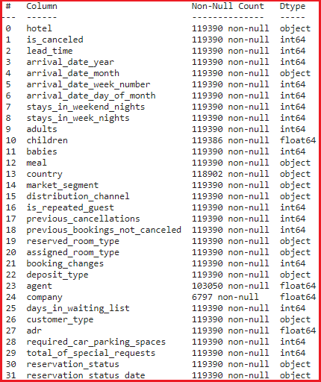

NaN value Handling
Total no. of rows / data = 119390
Here we can observe that four columns have some null values:
Children 119390 - 119386 = 4 null values.
Country: 119390 - 118902 = 488 null values.
Agent: 119390 - 103050 = 16340 null values.
Company : 119390 - 6797 = 112593 null values.
Here we can observe that in 'company' column 94.3% values are null.
Total rows which has null values = 16496
Total percentage of rows which has null values = 13.6 %

Slide 6
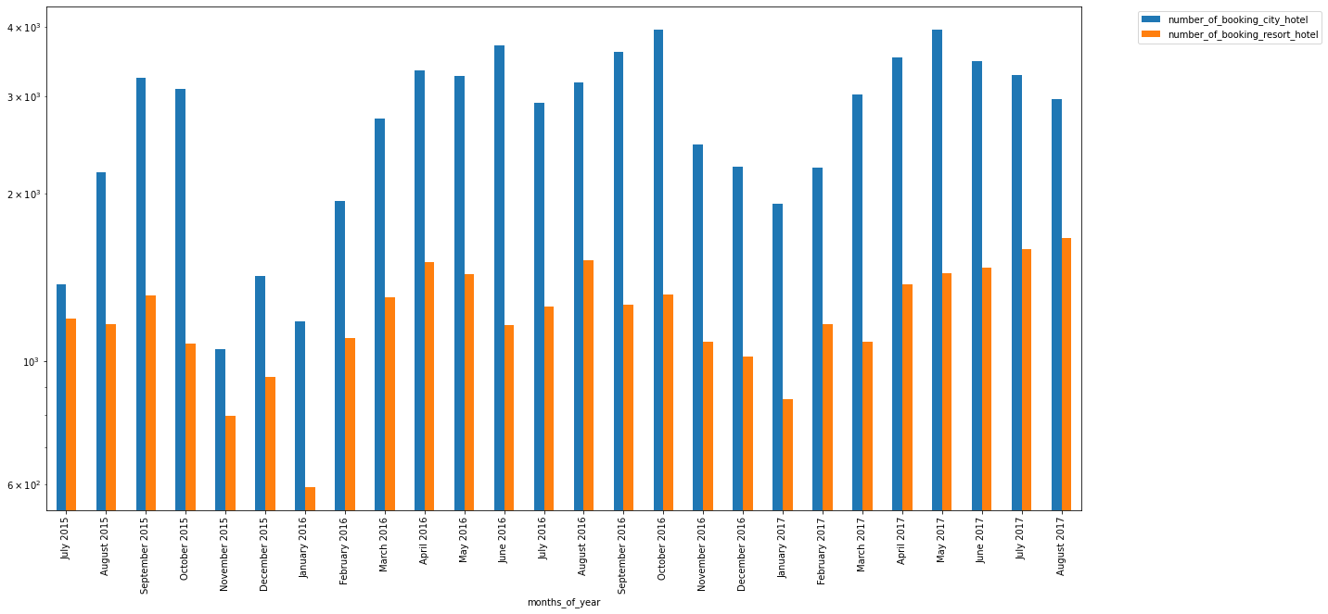
Monthly booking analysis
Total number of bookings

Slide 7
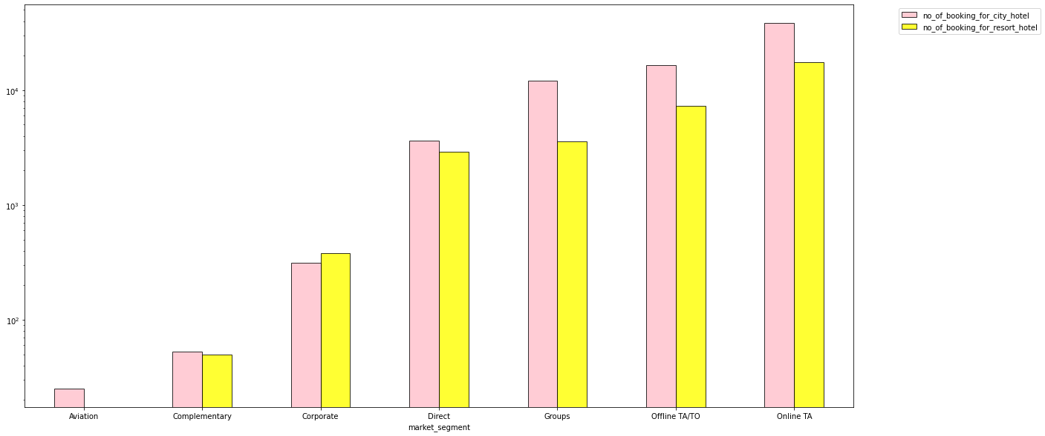
Bookings from different market segments

Slide 8
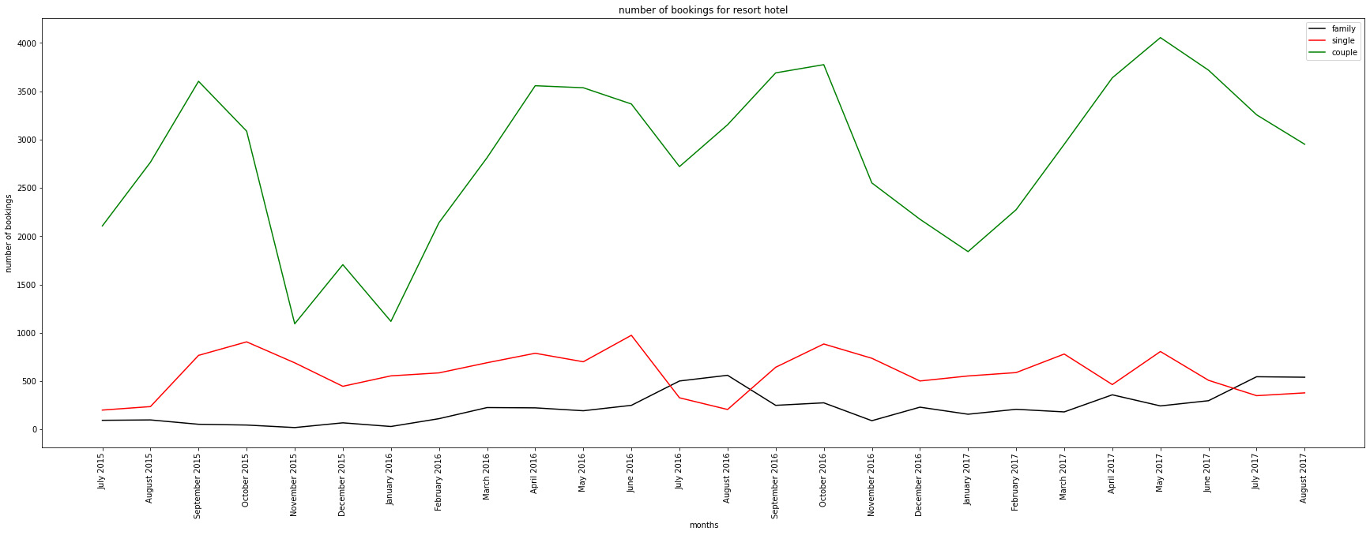
Average number of booking of couples, families and single for resort hotel

Slide 9
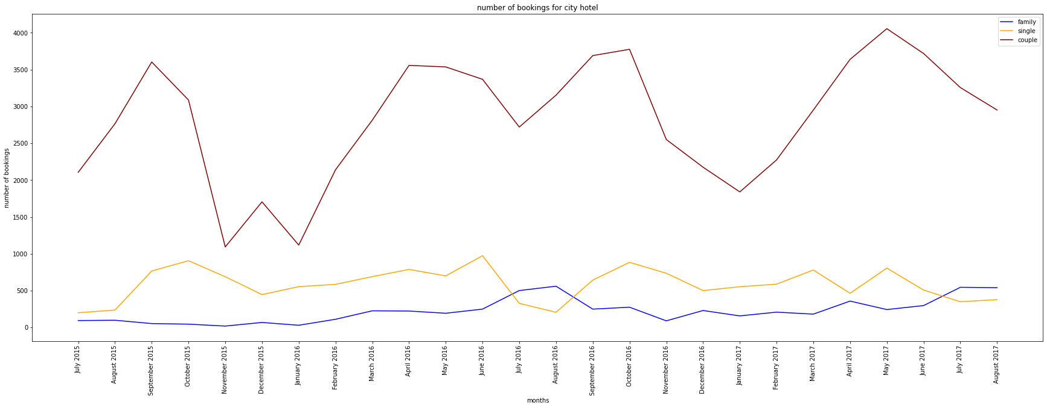
Average number of booking of couples, families and single for city hotel

Slide 10
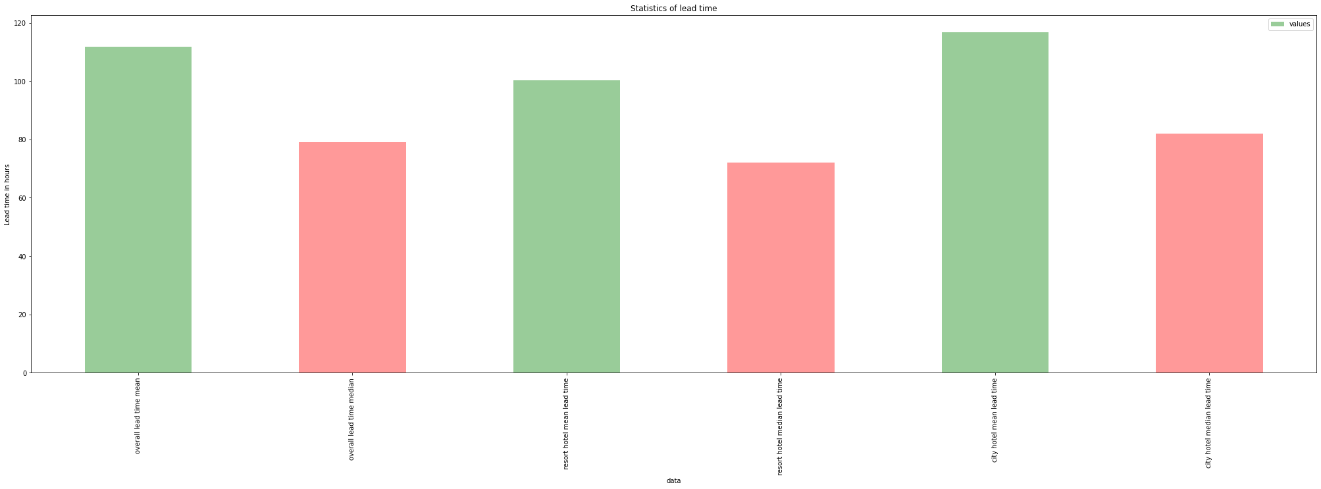
Statistics of lead time

Slide 11
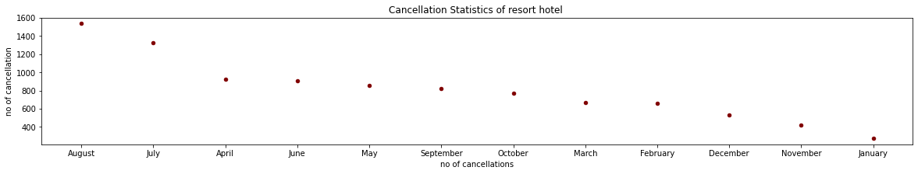
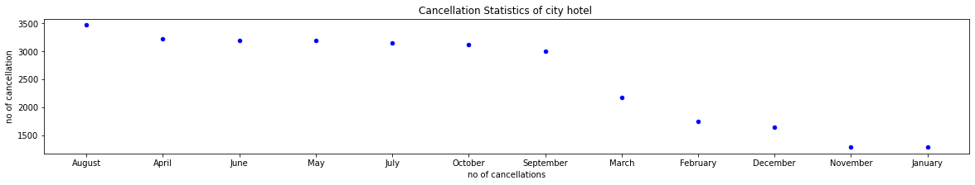
Cancellation statistics

Slide 12
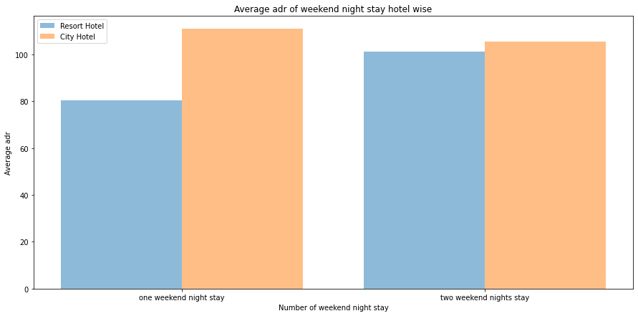
Adr for weekend nights

Slide 13
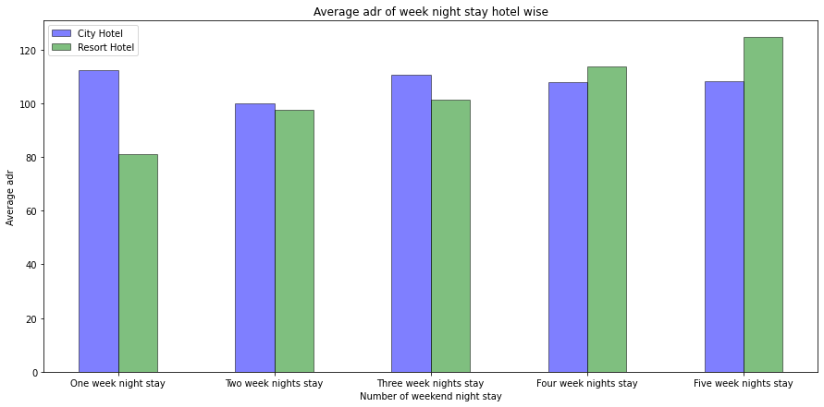
Adr for weekday nights

Slide 14
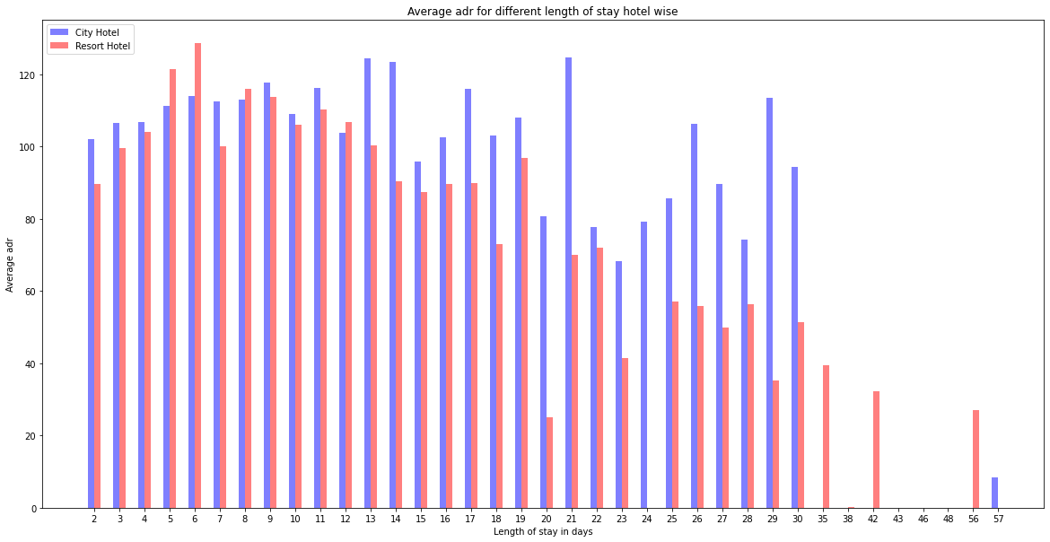
Adr vs. length of stay

Slide 15
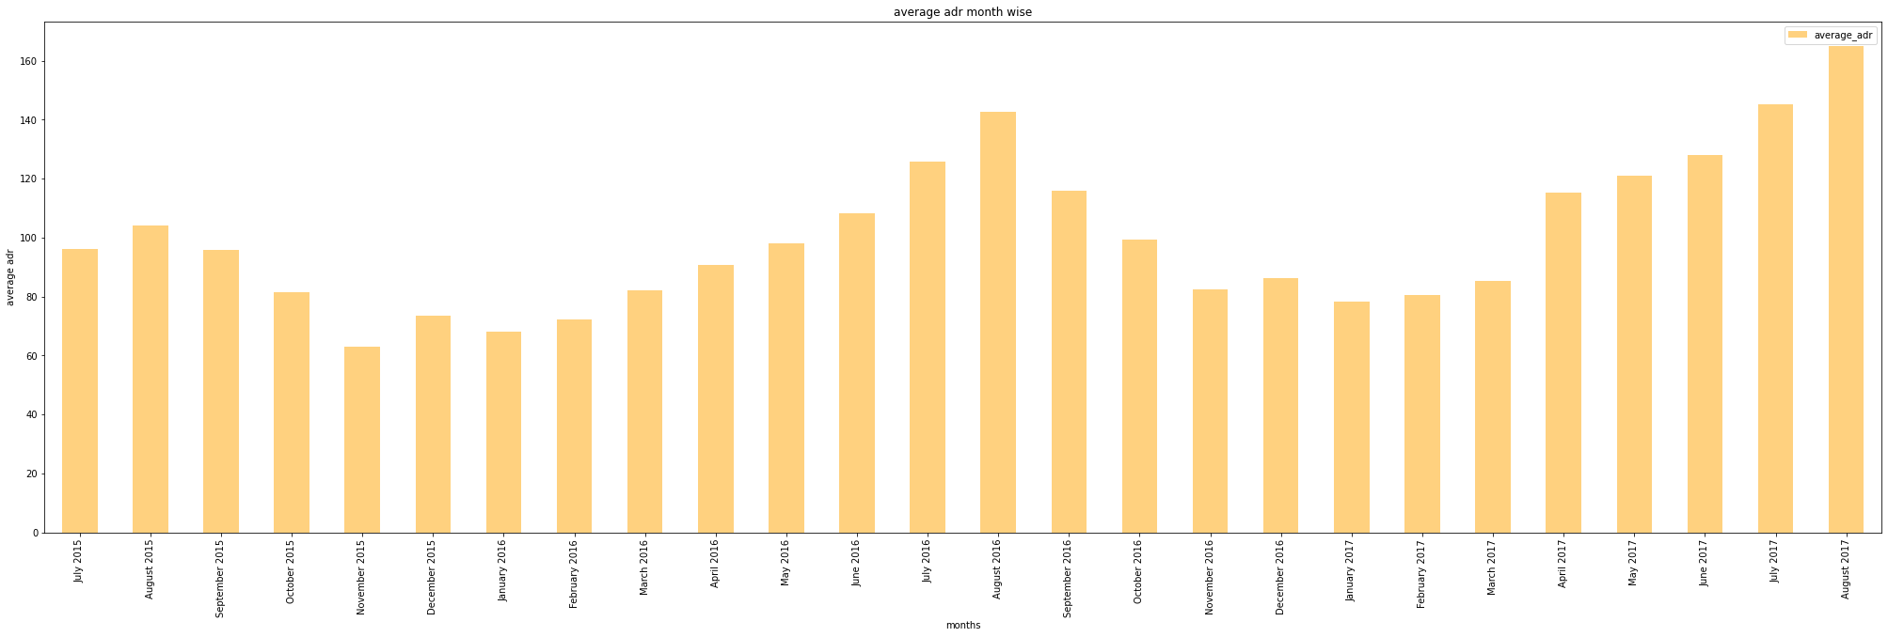
Variation of adr with time

Slide 16
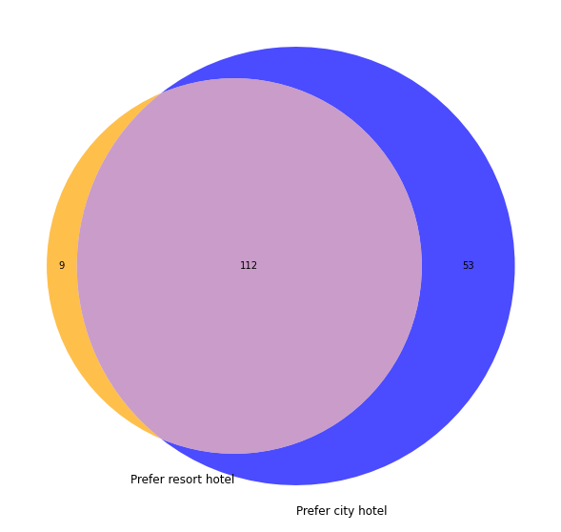
Choice of hotel from people of different countries

Slide 17
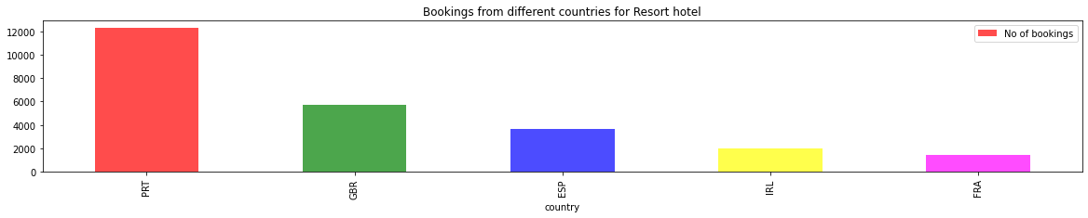
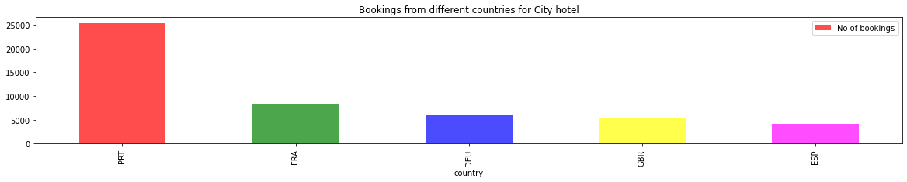
Bookings from different countries

Slide 18
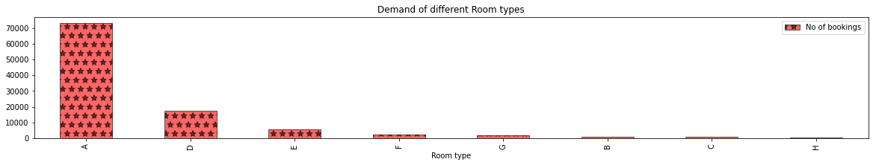
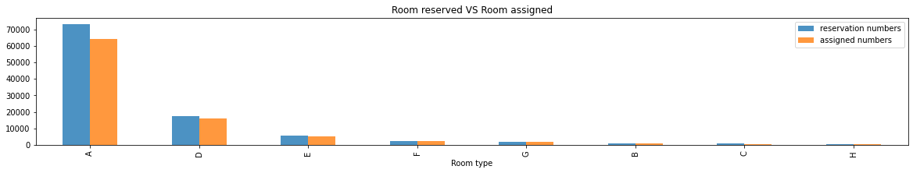
Demand of different Room type

Slide 19
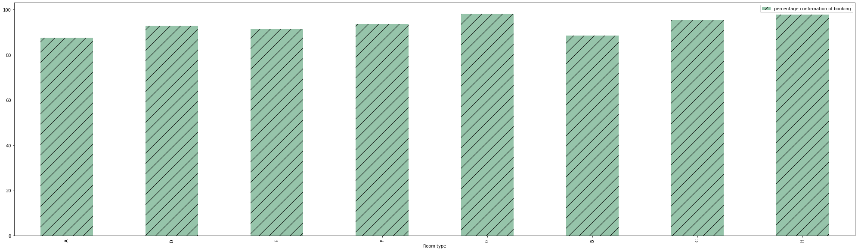
Percentage of confirmed booking for various room types

Slide 20

Food preferences of customers

Slide 21
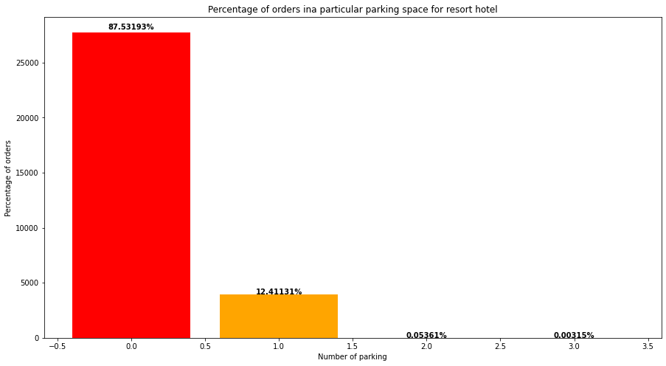
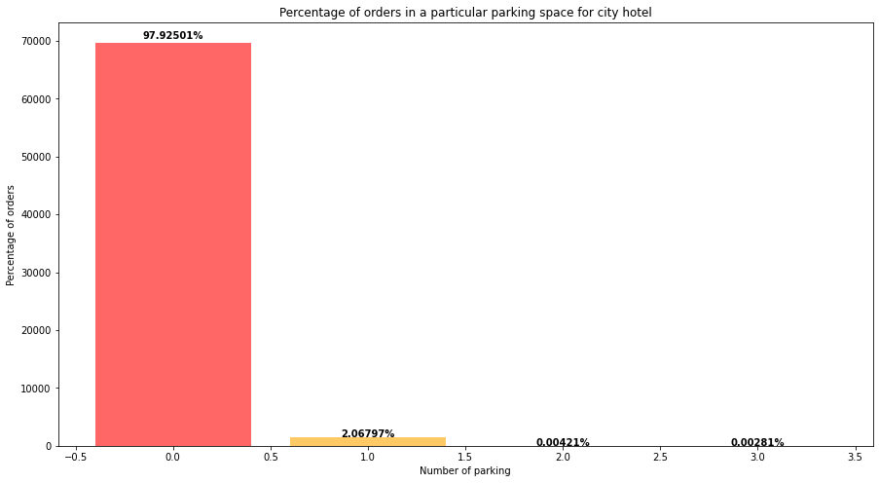
Parking space demand analysis

Slide 22
Challenges
Data Cleaning
More Data or Better Data
Understanding the business problem
Team coordination
Lack of clarity in data

Slide 23
Conclusion
Comparing the magnitude of booking we see that city hotel has always scored higher booking counts.
Number of booking start increasing from spring to summer season and then decrease till winter season.
TA(travel agents) are the major contributors of booking
The most number of cancelled booking is in the month of August.
Adr starts decreasing from month of september and it gets its minimum value in between november and january, after that adr starts increasing and it gets its peak in august.
BB is most preferred and FB is the least preferred meal.
Demand of type A room is highest followed by type D room.

Slide 24


